Slide 1
Detecting anti India campaigns on digital platforms
National CyberShield Hackathon 2025
Using AI & Data Analytics to Secure Our Digital Space
CODE4SHIELD
Baderia Global Institute of Engineering and Management Jabalpur

Slide 2





PROBLEM STATEMENTT
Current detection tools are limited and slow.
Anti-India campaigns on digital platforms are increasing rapidly
Propaganda spreads through: -
Fake accounts, bots, troll farms
Misleading news, memes, and videos
Multilingual and coded language
There is a need for an AI/data-driven solution for real-time detection.
Current detection tools are limited and slow .

Slide 3
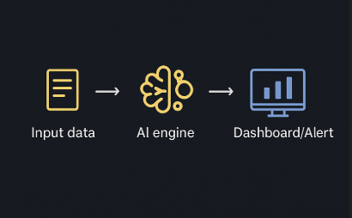
Idea / Proposed Solution
AI-powered real-time system for propaganda detection
Analyzes social media posts, videos & memes
Detects fake accounts, bots & troll farms
Supports multilingual & coded language detection
Instant alerts + centralized monitoring dashboard
Unique: Combines AI + API integration + Real-time alerts

Slide 4



Technical Approach
FILE.CSV
BACKEND
FRONTEND
Data Collection: Gather data from social media platforms (CSV, APIs, etc.)
Analysis & Detection: Use Python backend to classify content as Safe, Suspicious, or Neutral
Using Pandas, Flask, Chart.js libraries
/frameworks
Visualization: Display results using frontend (HTML, CSS, JS) with charts
Link :-https://github.com/imakasx/CyberShield-Hackathon2025/blob/main/file.csv
Link :-https://github.com/imakasx/CyberShield-Hackathon2025/tree/main/Backend
Link :-https://github.com/imakasx/CyberShield-Hackathon2025/tree/main/Frontend

Slide 5
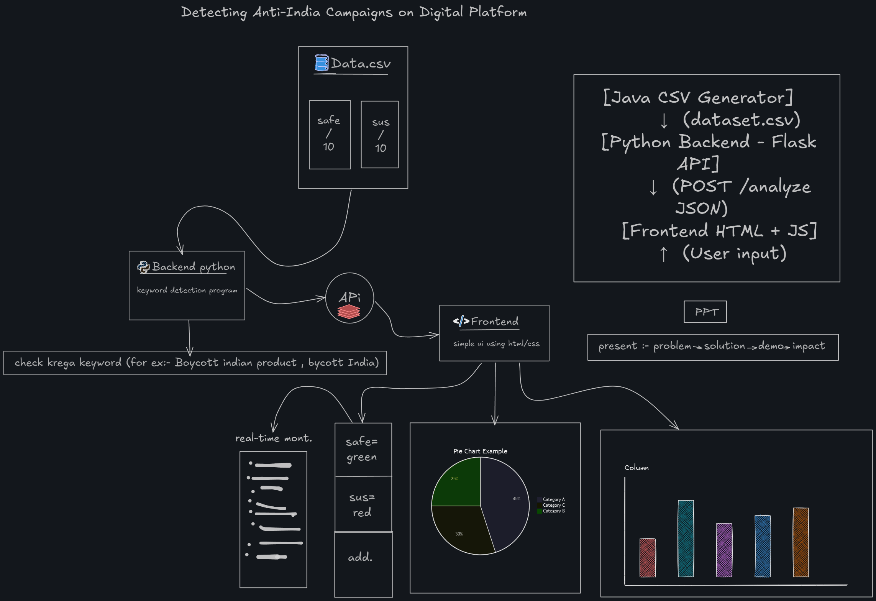
Workflow
Link :-https://github.com/imakasx/CyberShield-Hackathon2025/blob/main/Workflow.png

Slide 6
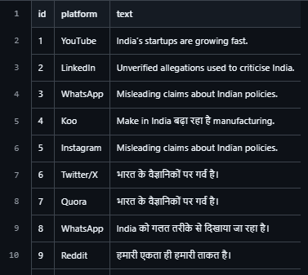
Sample Data Overview
File.csv
This CSV contains social media posts and metadata used for analysis.
Columns include: Post ID, Content, Language, Source, Timestamp
Helps backend process and detect suspicious posts efficiently.
Link:- https://github.com/imakasx/CyberShield-Hackathon2025/blob/main/file.csv
Java-based CSV Generator :-
Automates creation of input data for analysis
Supports columns like Post ID, Content, Language, Source, Timestamp
Handles large datasets quickly
Directly feeds backend Python scripts for detection
Reduces manual errors in data collection
Link:-https://github.com/imakasx/CyberShield-Hackathon2025/blob/main/SimpleCSV.java

Slide 7
Research distribution
Pie Chart: Shows the proportion of different research sources (papers, websites, datasets, open-source tools)
Bar Chart: Compares the number of references used from each category
Visualizes contribution of each source type to the project
Helps audience quickly understand the research distribution
Makes references data more interactive and engaging
20%
sus
45% safe
35%
natural
Frontend :
Link: https://github.com/imakasx/CyberShield-Hackathon2025/tree/main/Frontend

Slide 8
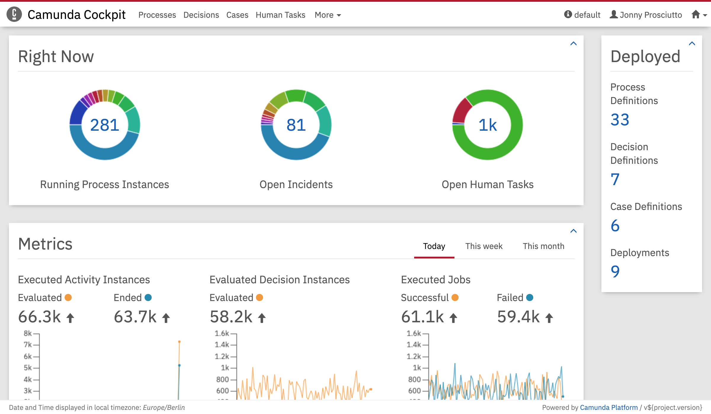



Backend Overview
Processes CSV data to detect content type (Safe / Suspicious / Neutral)
Generates actionable alerts for decision-makers
Sends results to frontend dashboard
Scalable and secure architecture
Analyzes CSV data to detect Safe / Suspicious / Neutral content
Generates alerts and sends results to frontend dashboard
Dashboard
link :-https://github.com/imakasx/CyberShield-Hackathon2025/tree/main/Backend

Slide 9
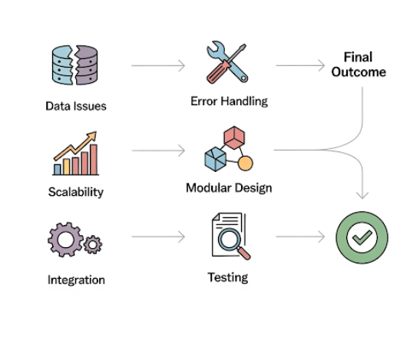
Feasibility And Viability
Assess technical, operational, and financial feasibility
Identify potential challenges and risks
Plan mitigation strategies (error handling, modular design, testing)
Ensure availability of tools, datasets, and skilled team members
Confirm project can deliver results effectively

Slide 10
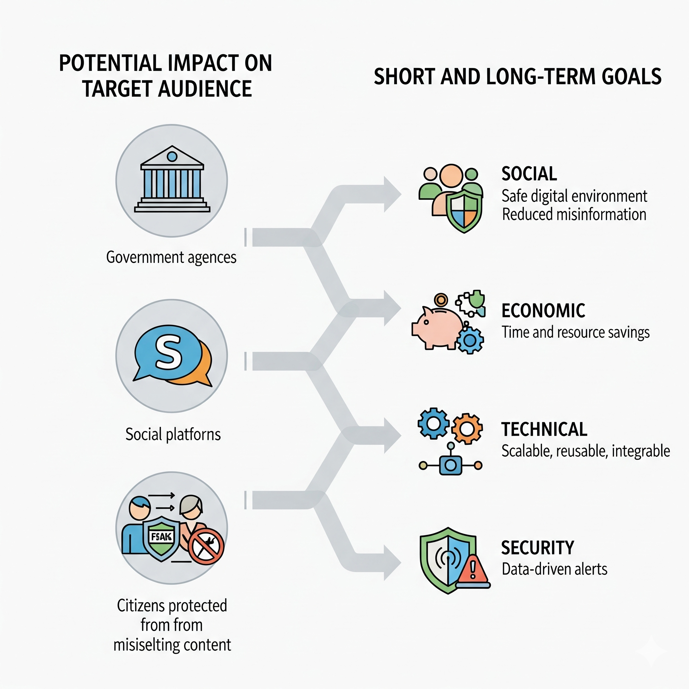
Impact and Benefits
Potential Impact on Target Audience
Helps government agencies and social media platforms detect anti-India campaigns faster
Protects citizens from misleading content and fake narratives
Improves social awareness and online safety
Short and long-term goals
Social: Promotes safe digital environment , reduces misinformation
Economic: Saves time and resources by automating detection
Technical: Scalable, reusable, and integrable with other systems
Security: Enhances data-driven decision making and alerts

Slide 11




References
Include direct links to online sources
Mention open-source tools, libraries, and datasets
Credit all external images, diagrams, and media
Ensure references are reliable and verifiable
books
Web link
Our
Project
Datasets
Code

Slide 12
Team Member Details :-
Reg. No/ Enrol. No | Name | Year/ Sem | Department | City/ State | Male/ Female | Mail Id | Mobile No.
0246IS221004 | Akash Vishwakarma | 7th | CSEIOT | Jabalpur MP | Male | akashvishwakarma0618@gmail.com | 8349019346
0246CS221132 | Neelesh Yadav | 7th | CSE | Jabalpur MP | Male | yneelesh684@gmail.com | 76107 11975
0246CS221170 | Sahil Kushwaha | 7th | CSE | Jabalpur MP | Male | sahilkushwaha822@gmail.com | 9752510729
0246CS221166 | Rupali Kachhi | 7th | CSE | Jabalpur MP | Female | rupalikachhi07@gmail.com | 9109369854
Mentor Details :-
Staff Id | Name | Department | Mail Id | Phone . No
7341 | Divya Pandey | CSE | divyap@global.org.in | 81095 51427

Slide 13
THANK YOU

